Slide 1
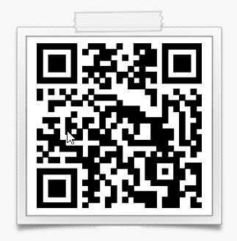
2024-2025 NISD FFA BREEDING & MARKET RABBIT INFORMATIONAL MEETING
Kristen Couture – EATON
Karleigh Howeth - NORTHWEST
Galena Morrin - BYRON NELSON
ALL PRICING INFORMATION WILL BE IN BLUE TEXT…..PRICING IS ESTIMATED ACTUAL COST MAY BE MORE OR LESS THAN MENTIONED

Slide 2
Two Rabbit Project Options
Breeding Rabbits:
You will keep the rabbit until you decide to sell it.
These can go to every show.
You can show them for multiple years.
$75 - $150…. $100 average/target
Market Rabbits:
A six week project.
Meat Pen is a set of 3 rabbits.
Your fourth rabbit will show as a single fryer for $5.
Denton County only
Estimated $200-300 per pen of four rabbits

Slide 3
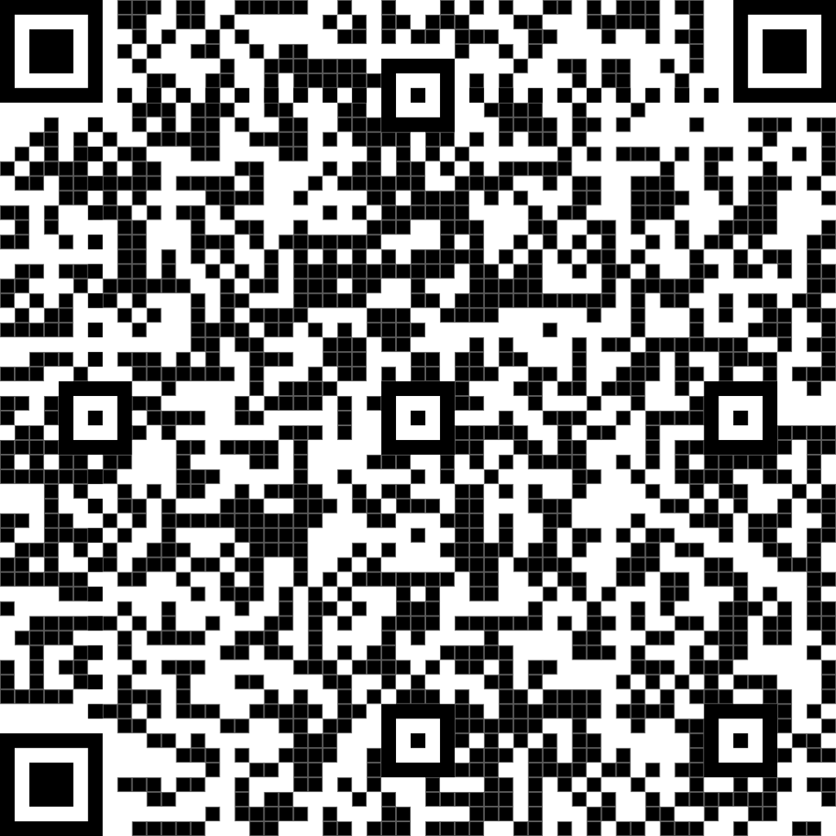
PURCHASING
We recommend that we purchase/assist with purchase of all animal projects
Any animals purchased on your own must be approved by Mrs. Couture, Ms. Howeth and/or Mrs. Morrin
Students can show a Buck (male) or Doe (female)
Cost
Can range depending on the budget
$75 - $150…. $100 average/target
Rabbit Purchase Form: Purchase Form Link

Slide 4
TYPES/BREEDS
Visit www.arba.net
Click on about the ARBA
Recognized breeds
Pick a breed
We cannot guarantee that we can get a specific breed, but will try.
If you shop on your own (rabbit MUST be registered with the ARBA) obtain pedigree when picking up the rabbit from the breeder

Slide 5
TATTOO
Required for all rabbits as a method of registering and identifying rabbits with the show and matching registration papers.
Must be in the left ear
Teachers can touch up tattoos if needed

Slide 6
NEEDED SUPPLIES
Cage/ Hutch
Tube Style water bottle
Hanging feeder or flat bottom bowl
Kitty litter or pee pads for dropping pan
Litter box for corner if no dropping pan / Shaving/ bedding – not cedar
Rabbit transport carry cage
Use to take rabbit to shows
kwcages.com
allthingsbunnies.com
bunnyrabbit.com
Amazon
Feed 16% -18%
16% in hot months
18% in cooler months
Timothy Hay
Nail clippers
Hay Manger

Slide 7
FACILITY / JOINING FFA
Kelly W. Box Agriculture Science Complex
We will host rabbit clinics starting the end of October.
Open for use of any NISD FFA Member
Byron Nelson FFA Member/Jr Member
$40 for Byron Nelson HS & $20 for Jr. FFA dues
Eaton FFA Member/Jr Member
$40 for HS Dues & $20 for Jr FFA Dues
Northwest FFA Member/Jr Member
$40 HS Dues & $20 Jr FFA Dues
Bi-Weekly Clinics – Tuesdays
See schedule
Notes:
Deadline:
EHS Jr - September 22
EHS - October 19
NHS - October 19
BNHS - October 19

Slide 8
SHOWS ATTENDING - 2025
Sonny Nance (Premium) Livestock Show
Kelly W. Box Ag Center
January 10th ($10 / rabbit)
San Angelo - Youth
February 14th - TENTATIVE
($5 / rabbit)
Parent required
Houston Livestock Show - Youth Breeding
March 2025 - TENTATIVE
Breeds divided by waves on different days
Limited Entries - decide ASAP
Denton County - Breeding and Market
April 1 - TENTATIVE
Breeding Rabbits: $20, 1st rabbit, $5 for every additional rabbit
Pen of 3 market rabbits $25 per entry
Single Fryer Jackpot $5.00 One Validated rabbit - Pay cash the day of the show.

Slide 9
TEACHERS NOT ATTENDING
BUT STILL RECOMMENDED
Fort Worth Stock Show – Open
Jan 24th - 26th ($5 / rabbit)
Fort Worth Stock Show – Youth
Feb 30th - 1st ($5 / rabbit)
Plenty of wonderful parents attending that would be willing to help! Ag teacher(s) may attend on weekends to help when needed.

Slide 10
STOCK SHOW SIGN-UP NIGHT
Event held at the Kelly W. Box Ag Center
Address: 1960 Texan Drive Justin, Texas 76247
October 1st and November 7th
5-7 pm
Will sign up for all shows attending and collect all entry fees.
Mandatory
Bring or know SS# for student showing the animal
Watch for email the week before sign up with all entry forms attached, please fill them out and bring to the sign-up night.

Slide 11
OTHER COSTS
Vet Care visits is the responsibility of the student/parent
Jackpot (Practice) Show Entries (typically $10 - $20)

Slide 12
EXPECTATIONS
Attend bi-weekly rabbit clinics at Ag Center
Feed rabbit 1 to 2 times per day – depends on animal
Keep pen and surrounding areas clean
Exercise 2-3 times a week on your own
It is easier to keep a rabbit clean than clean them up once they are dirty, NO BATHS (this will alter their hair for the show).

Slide 13
BI-WEEKLY MEETINGS
We will meet at the Barn about every other Tuesday afternoon. These dates are listed on the clinic schedule, from 5pm to 6pm
It is the expectation that students come to these clinics for teachers to follow projects better.
Please let teachers know if you are not able to attend a clinic.
Will need to bring animals as they are not kept at the facility
Will be covering
Showmanship
Handling/Training
Exercising
Feed Alterations
Clipping nails
Other additional topics as needed
Notes:
All students should attend weekly clinics. Veteran students will help facilitate and teacher newer students with their rabbits. Attendance will be taken at each clinic for teacher record.

Slide 14
TRAVEL
Families will be responsible for personal travel and food at each show.
We CAN assist in the transport of animals, but will possibly need parent assistance.
Hotels
Families are responsible for their own hotels
Book now!

Slide 15
COMMUNICATION
Parent Square: Email galena.morrin@nisdtx.org and I will get you added to the NISD Rabbit group

Slide 16
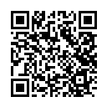
COMMUNICATION
Parent Square: SCAN THE LINK TO ADD YOURSELF TO THE group!

Slide 17
QUALITY COUNTS
This is an online class that students must complete in order to show at the major livestock shows.
The link and login information will be sent out via email first week of October.
EVERY HIGH SCHOOL and JR. FFA MEMBER will have to go through the Quality Counts Training and Test.

Slide 18
OUR CONTACT INFORMATION
Please do not share or abuse our personal phone numbers if you have them.
Galena Morrin
Email: galena.morrin@nisdtx.org
Karleigh Howeth:
Email: karleigh.howeth@nisdtx.org
Kristen Couture
Email: kristen.couture@nisdtx.org
Use the Parent Square to Communicate too.

Slide 19
ADDITIONAL INFORMATION
More information and handouts
At www.vreaton.ffanow.org & www.byronnelson.ffanow.org/
Under the SAE TAB
Select: NISD Rabbits

Slide 20
TO DO…
Purchase Form Link
https://forms.gle/FRkShEL6UNkPZCim6
Please scan and fill this form out so we can track an accurate form of communication for the year.
Deadline to give money to Ag Teacher for rabbit project:
Tuesday September 17th - 5 pm - 7 pm
Cost $75 - $150
Cash
Drop fee at:
Kelly W. Box Ag Center
1960 Texan Dr
Justin, TX 76247
Deadline to pay FFA Dues:
All High Schools
$40
Due to your campus AST 10/11/24
Jr FFA
$20
Due to a rabbit advisor of your feeder pattern at a Rabbit meeting by 9/17/24
Deadline October 11th for high school dues and Jr FFA dues can be paid on September 12th.

Slide 21
NISD Alumni and Parent Board
Monthly meetings are listed on our clinic schedule.

